Slide 1
IT-331 ( Computer Graphics 1)
Lecture 6
Two Dimensional Geometric Transformations
Dr. Mohammed El-Said
Assistant Professor, Computer Science Dept.,
Faculty of Computers & Artificial Intelligence,
Helwan University - Cairo, Egypt.

Slide 2
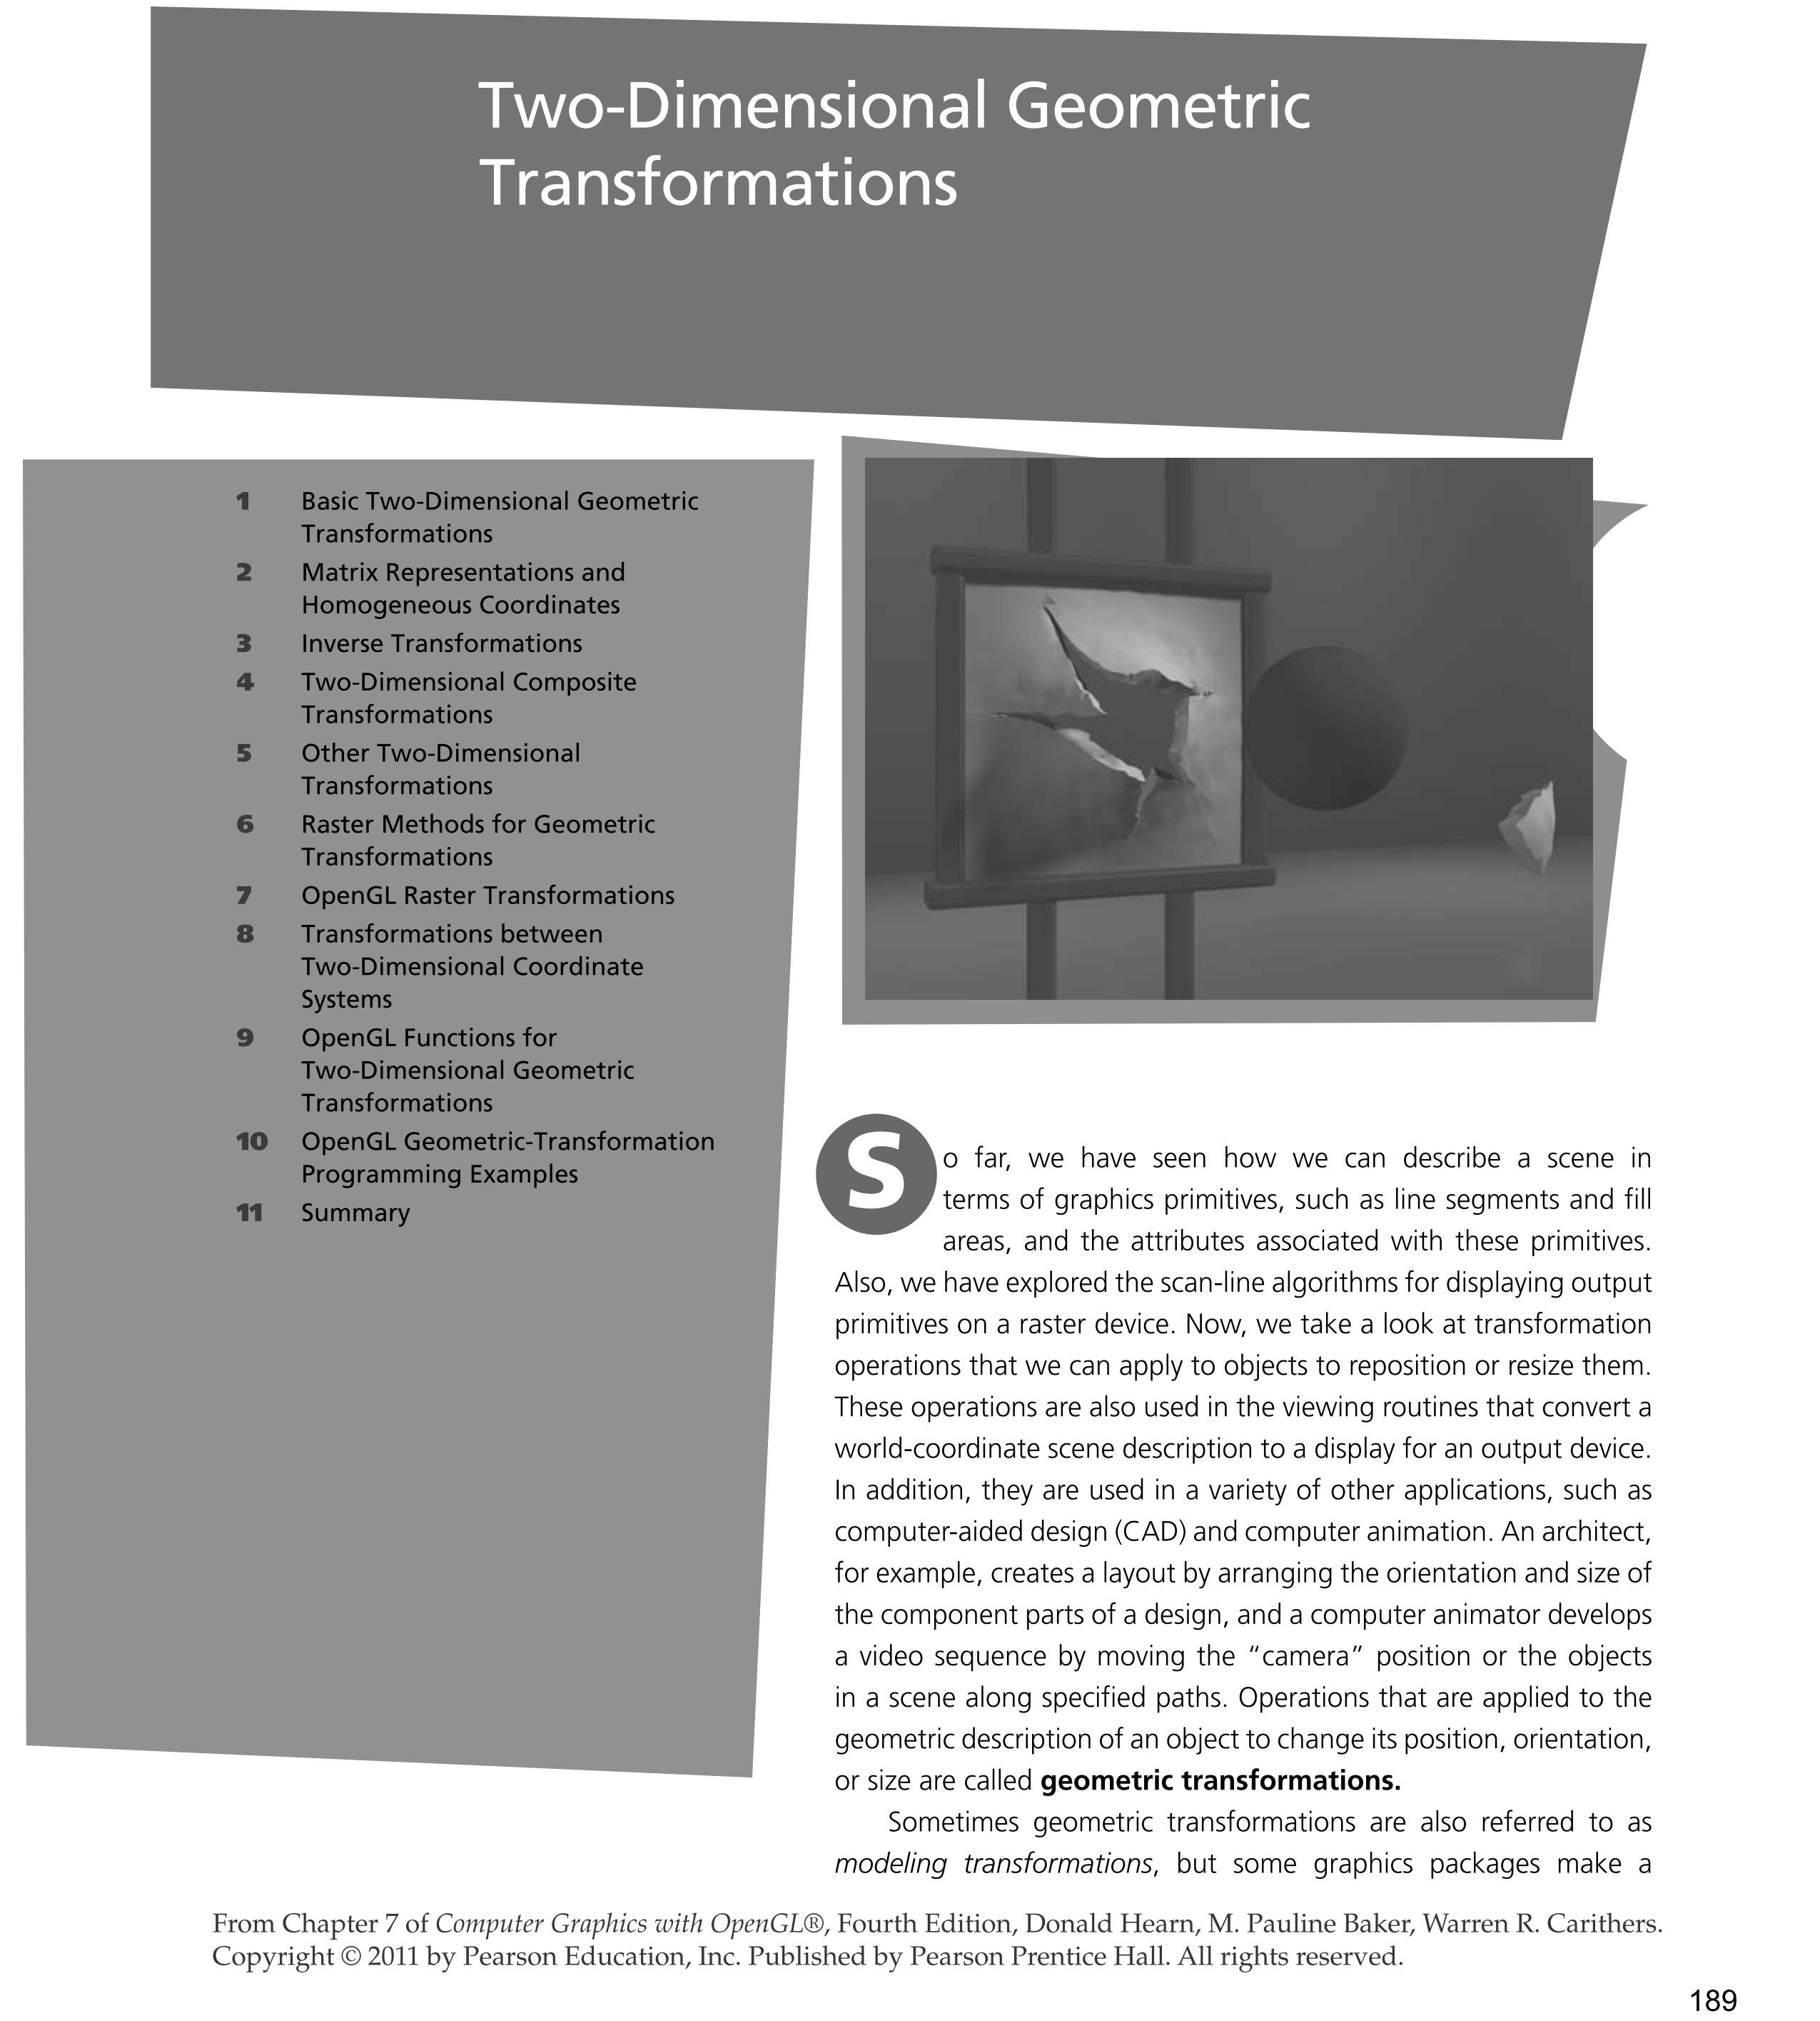

Slide 3
Geometric transformation functions
Translation
Scaling
Rotation
Reflection
Shearing

Slide 4
2D Translation
Translate over vector (t_{x}, t_{y})
x’=x+ t_{x}, y’=y+ t_{y}
or
y
P+T
T
P
x

Slide 5
2D Translation polygon
Translate polygon:
Apply the same operation on all points.
Works always, for all transformations of objects defined as a set of points.
y
T
x

Slide 6
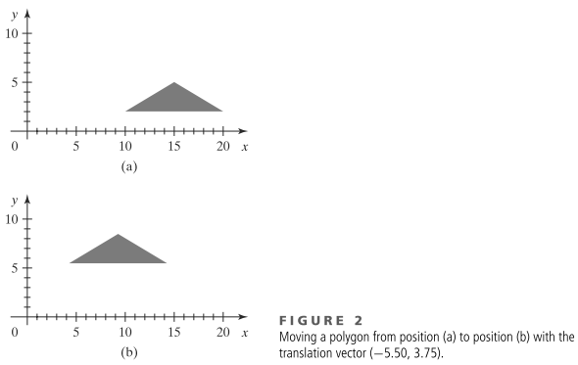
2D Translation polygon

Slide 7
2D Scaling from the origin
P’
P

Slide 8
2D Rotation about the origin
y
θ
P’(x’,y’)
P(x,y)
r
r
x

Slide 9
2D Rotation about the origin
y
P’(x’,y’)
P(x,y)
r
θ
y
φ
r
x
x

Slide 10
2D Rotation about the origin
y
P’(x’,y’)
P(x,y)
r
θ
y
φ
r
x
x

Slide 11
2D Rotation about the origin
Substituting for r :
Gives us :

Slide 12
2D Rotation about the origin
Rewriting in matrix form gives us :

Slide 13
Transformations
Translation
P′=T + P
Scale
P′=S ⋅ P
Rotation
P′=R ⋅ P
We would like all transformations to be multiplications so we can concatenate them ⇒ express points in homogenous coordinates.

Slide 14
Transformations
Messy!
Transformations with respect to points: even more messy!
How to combine transformations?

Slide 15
Rotation around a point Q
Messy!
y
y
P’
α
P
P−Q
Q
x
x

Slide 16
Scaling with respect to a point F
Messy!
y
Scale with factors s_{x} and s_{y}:
P_{x}’= s_{x} P_{x}, P_{y}’= s_{y}P_{y}
With respect to F:
P_{x}’ − F_{x} = s_{x} (P_{x} − F_{x}),
P_{y}’ − F_{y} = s_{y} (P_{y} − F_{y})
or
P_{x}’= F_{x} + s_{x} (P_{x} − F_{x}),
P_{y}’= F_{y} + s_{y} (P_{y} − F_{y})
P’
P
P−F
Q’
F
Q
x
x

Slide 17
Homogeneous coordinates
Uniform representation of translation, rotation, scaling
Uniforme representation of points and vectors
Compact representation of sequence of transformations

Slide 18
Homogeneous coordinates
Add an extra coordinate, W, to a point.
P(x,y,W).
Two sets of homogeneous coordinates represent the same point if they are a multiple of each other.
(2,5,3) and (4,10,6) represent the same point.
At least one component must be non-zero ⇒ (0,0,0) is not defined.
If W≠ 0 , divide by it to get Cartesian coordinates of point (x/W,y/W,1).
If W=0, point is said to be at infinity.
Notes:
V. important

Slide 19
Homogeneous coordinates
If we represent (x,y,W) in 3-space, all triples representing the same point describe a line passing through the origin.
If we homogenize the point, we get a point of form (x,y,1)
homogenised points form a plane at W=1.
W
P
W=1 plane
X
Y

Slide 20
Translations in homogenised coordinates
Transformation matrices for 2D translation are now 3x3.

Slide 21
Concatenation
We perform 2 translations on the same point:

Slide 22
Concatenation
Matrix product is variously referred to as compounding, concatenation, or composition

Slide 23
Concatenation
Matrix product is variously referred to as compounding, concatenation, or composition.
This single matrix is called the Coordinate Transformation Matrix or CTM.

Slide 24
Properties of translations
Note : 3. translation matrices are commutative.

Slide 25
Homogeneous form of scale
Recall the (x,y) form of Scale :
In homogeneous coordinates :

Slide 26
Concatenation of scales

Slide 27
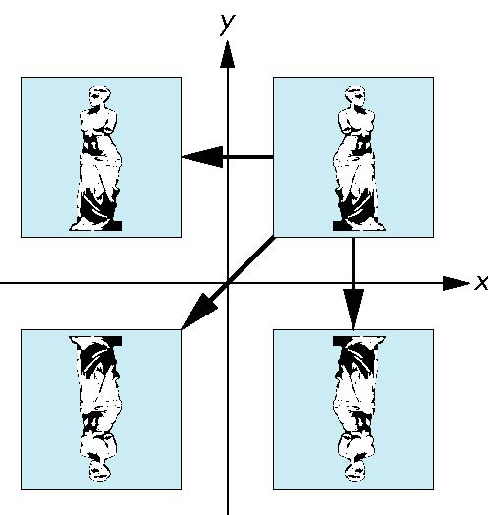
Reflection
corresponds to negative scale factors
s_{x} = -1 s_{y} = 1
original
s_{x} = -1 s_{y} = -1
s_{x} = 1 s_{y} = -1

Slide 28
Homogeneous form of rotation
i.e. the inverse is the transpose

Slide 29
Orthogonality of rotation matrices.

Slide 30
Other properties of rotation.

